Slide 1
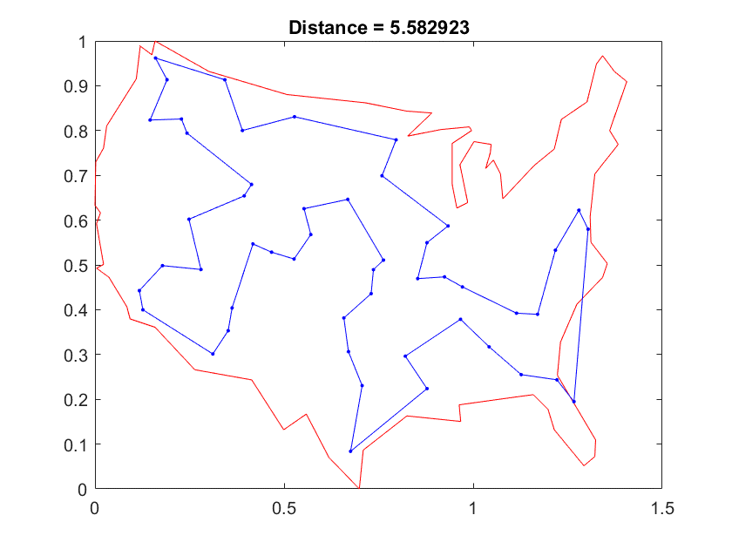
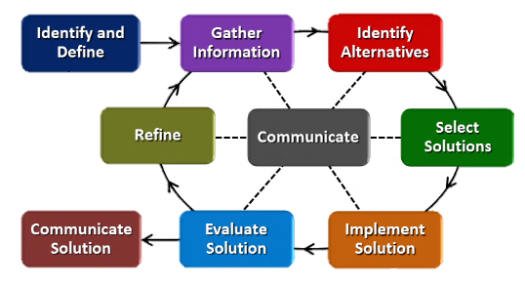
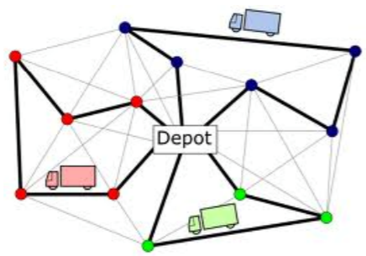
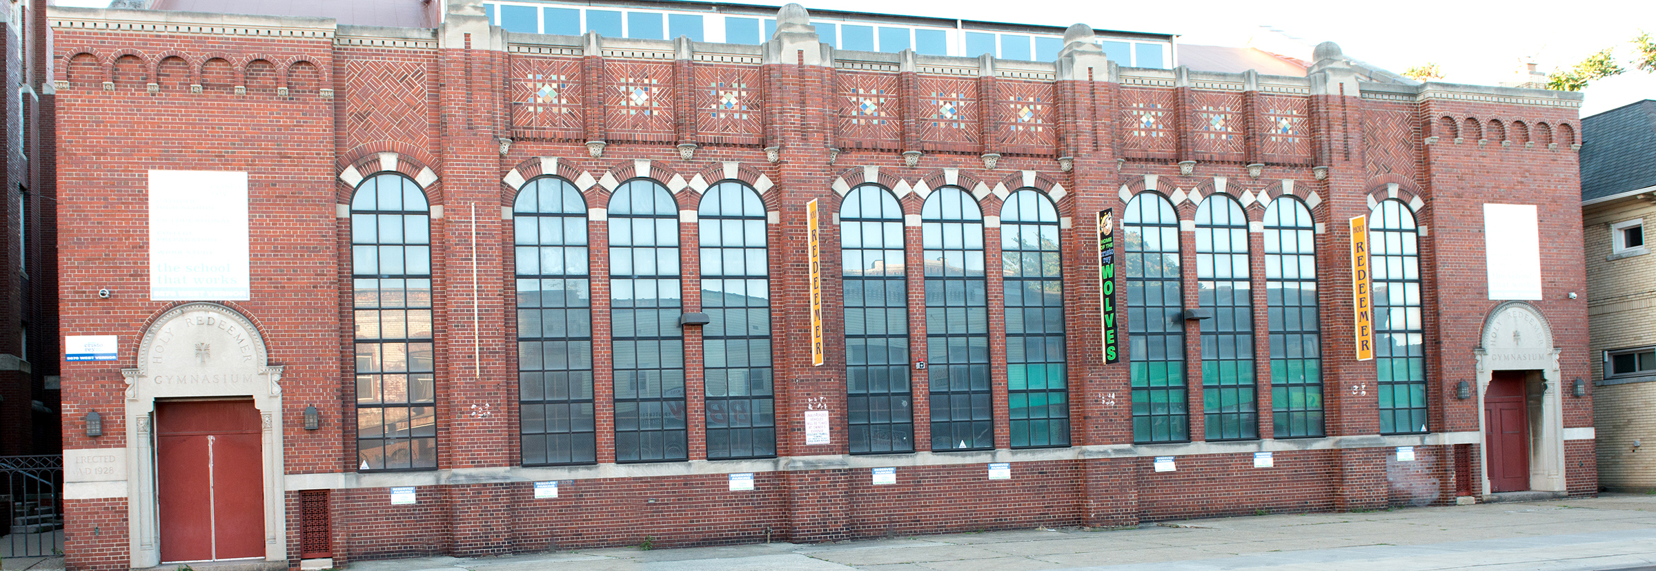
Route Optimization Matthew Bagazinski Detroit Cristo Rey High School, Physics
RET is funded by the National Science Foundation, grant # EEC-1710826
Solving the Travelling
Salesman Problem
Engineering Design in a
Science Classroom
Designing an Efficient
School Day
How do we identify a problem that needs to be solved?
What are possible ways to solve the problem?
How much energy do we use every day?
What is the shortest path that touches all of the given locations?
Engineering Design Process
As the number of locations becomes large, how can a computer calculate a reasonably short path quickly?
How can we minimize our energy use? How can we maximize it?
Where could a central location be placed to allow multiple, short trips?
What is the best way to communicate results for someone else to use?
How should the locations be clustered for each trip?

